Slide 1
Principals of Robotics Perception, cognition and Actions
By Ramakant Ganjeshwar

Slide 2
Principal of Robotics
Perception
Cognition
Actions

Slide 3
Principal of Robotics helps
Guiding now robotics
Sense
Thinks
Act as a human in there environment

Slide 4
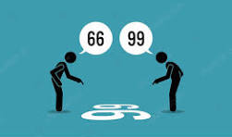
Perception
Sensor
Signal processing
Sensor fusion

Slide 5
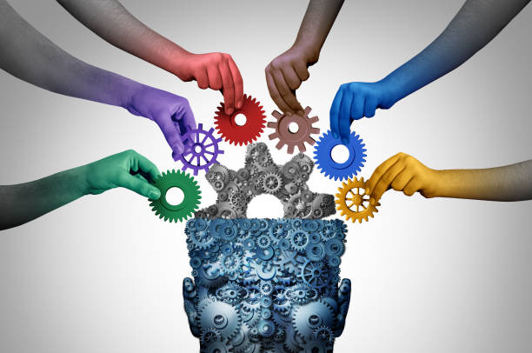
Cognition
World modeling
Decision Making
Learning
Reasoning

Slide 6

Actions
Motion Planning
Control System
Feedback loops
Human Robot interaction

Slide 7
Conclusion
These principals are interconnected and Work together to enable robots to operate Autonomy adapt to new situations and perform task in complex environment

